Slide 1

Enhancing Super-Resolution using Wavelet Transform and Multi-Frame Super-Resolution
Project Presentation
Presented by
Obinna Agbo
Mohamed Elgouhary

Slide 2
Outlines
Introduction
Problem Statement
Motivation & Significance
Related Work
Proposed System
Experimental Setup and Results
Conclusion & Next Steps

Slide 3
Introduction
The resolution of an image determines how much information can be extracted from it.
As a result, we are obliged to use zoom to enlarge the image areas.
Unfortunately, when we zoom past the current resolution, the interpolation procedure results in a blurry LR image.
It will be exceedingly difficult and deceptive to understand an image if it is degraded.

Slide 4
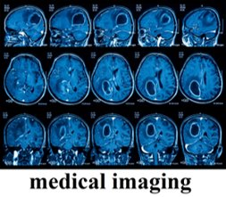

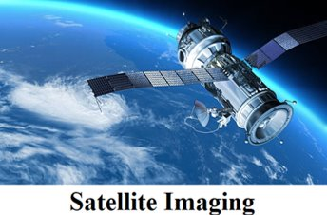

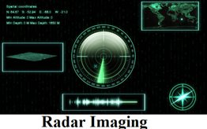
High-resolution images are often required and desired for most applications. Despite the availability of HR digital cameras, many computer vision applications need higher-resolution images that often exceed the capability of these HR digital cameras.
Introduction

Slide 5
Problem Statement
The best utilization of image sensors and optical technologies to increase the image pixel density is usually restrictive and overpriced.
Employing an image processing technique to build a high-resolution (HR) image from a low-resolution (LR) one is a costly and comprehensive option.
There is a need for software tools such as deep neural networks to acquire HR images from the available LR ones.
The time it takes to train a deep network may be long at first, but once it is trained, it gives the desired results in a reasonable amount of time.
Despite the availability of HR digital cameras, many computer vision applications need higher-resolution images that often exceeded the capability of these HR digital cameras.

Slide 6
Motivation & Significance
• High-quality SR is crucial for applications like medical imaging, satellite imaging, and surveillance.
• Current methods introduce artifacts and fail to recover high-frequency details.
• Wavelet Transform helps enhance fine details, while multi-frame SR leverages temporal data.
• Improved SR techniques contribute to better video and image processing solutions.

Slide 7
Project Objective
• The main objective of this project is to generate HR video frames from the available LR ones.
Single-image super-resolution lacks the ability to leverage temporal information.
• Design a Multi-Frame Super-Resolution Technique by using Wavelet Multi-Scale Convolutional Neural Networks.
• A comparative study between The proposed technique and other techniques to evaluate The proposed Technique.

Slide 8
Related Work
• SRCNN: Early deep learning-based SR model.
• ESRGAN: Uses adversarial training for better perceptual quality.
• Wavelet-Based SR: Studies explore wavelet decomposition for noise reduction and detail enhancement.
• Multi-Frame SR: Traditional methods use optical flow; deep learning models integrate temporal information.

Slide 9
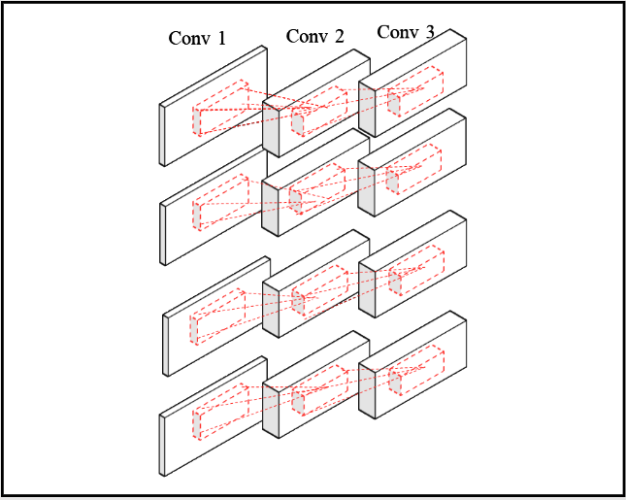
The Proposed System
The proposed System used four traditional Super-Resolution Convolutional Neural Networks with three layers (SRCNN)

Slide 10
VDSR vs. WSR
VDSR has 20 weight layers | WSR has three-layered four CNNs trained in parallel in decomposed frequency sub-bands
VDSR uses the entire multi-frame images as input for training one comprehensive model | The proposed technique uses CNNs to restore multiple frequency sub-bands

Slide 11
Convolutional Neural Networks (SRCNN) Specifications
f1 | f2 | f3 | n1 | n2 | p1 | p2 | p3 | a1 | a2 | a3
9 | 1 | 5 | 64 | 32 | 9 | 5 | 5 | relu | relu | linear
f1 is the first convolutional filter size
f2 is the second convolutional filter size
f3 is the third convolutional filter size
n1 is the number of the first convolutional filters
n2 is the number of the second convolutional filters
p1 is the first convolutional patch size
p2 is the second convolutional patch size
p3 is the third convolutional patch size
a1 is the first convolutional activation type
a2 is the second convolutional activation type
a3 is the third convolutional activation type.

Slide 12
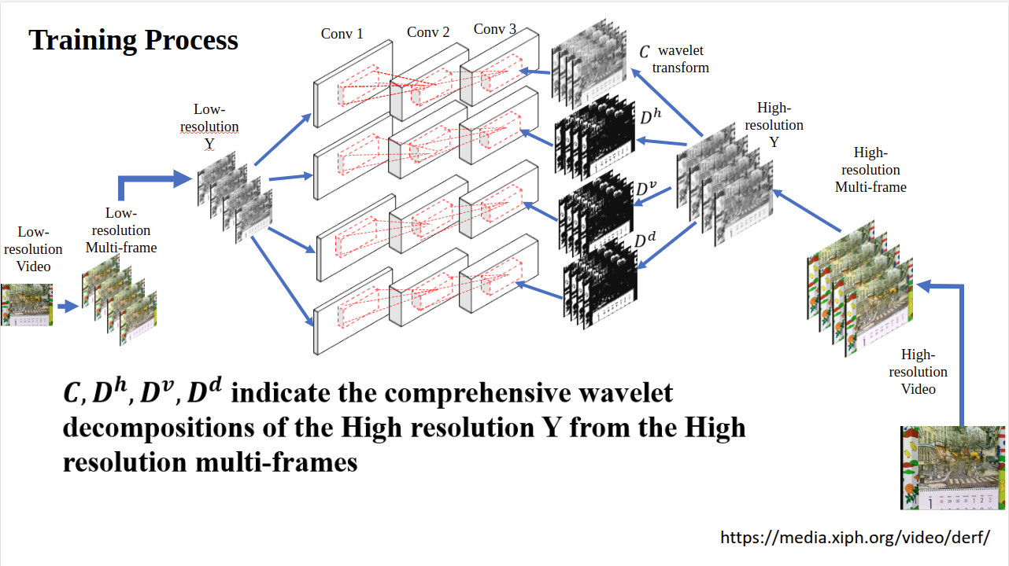

Slide 13
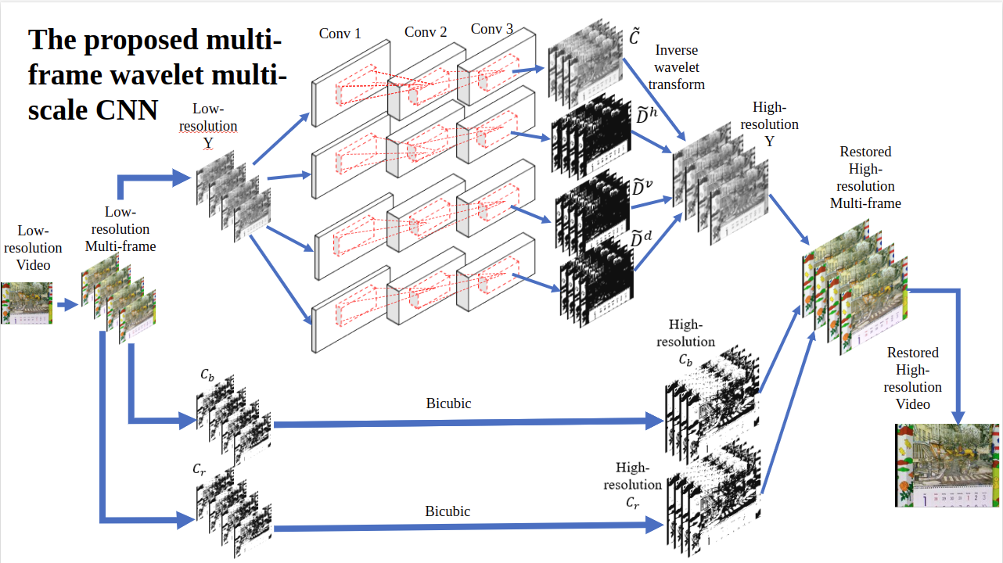

Slide 14
Resources
The training process utilized a set of 25 video sequences in the YUV format, commonly used in video SR research. These sequences were preprocessed into smaller overlapping volumes of spatial dimensions 32 × 32 pixels and a temporal duration of 10 frames, generating approximately 41,000 training samples.
Test Videos:
Four standard videos—City, Calendar, Foliage, and Walk—were used to assess the performance. These videos are widely employed as benchmarks in SR research.

Slide 15
Evaluation Metrics
• Experiments are carried out using upscaling factors of two and four.
The quantitative evaluation employed both distortion-based and perceptual-based metrics to assess the quality of the reconstructed high-resolution (HR) frames. PSNR and SSIM evaluate fidelity and structural similarity, respectively.
No-reference metrics, such as the Natural Image Quality Evaluator (NIQE) and Blind/Referenceless Image Spatial Quality Evaluator (BRISQUE), were employed to evaluate perceptual quality.
• Qualitative Analysis: Visual comparison and subjective user evaluation.

Slide 16
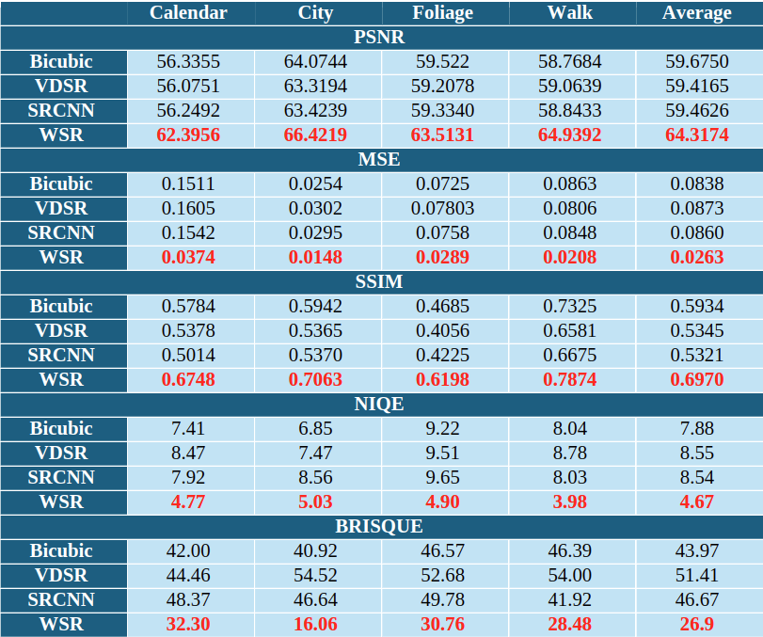

Slide 17
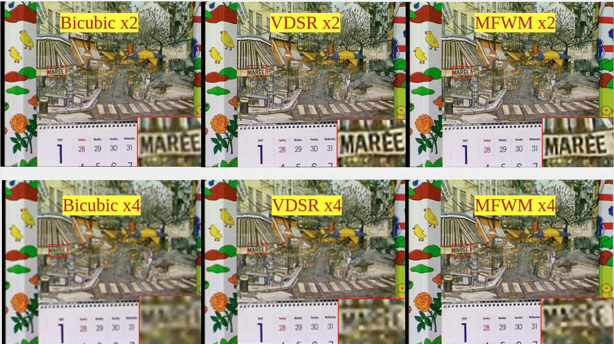

Slide 18
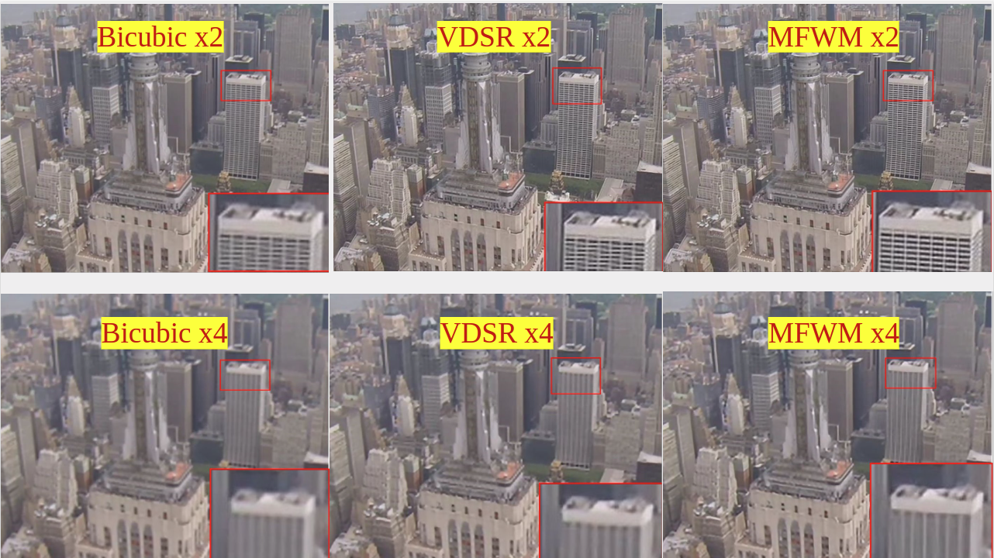

Slide 19
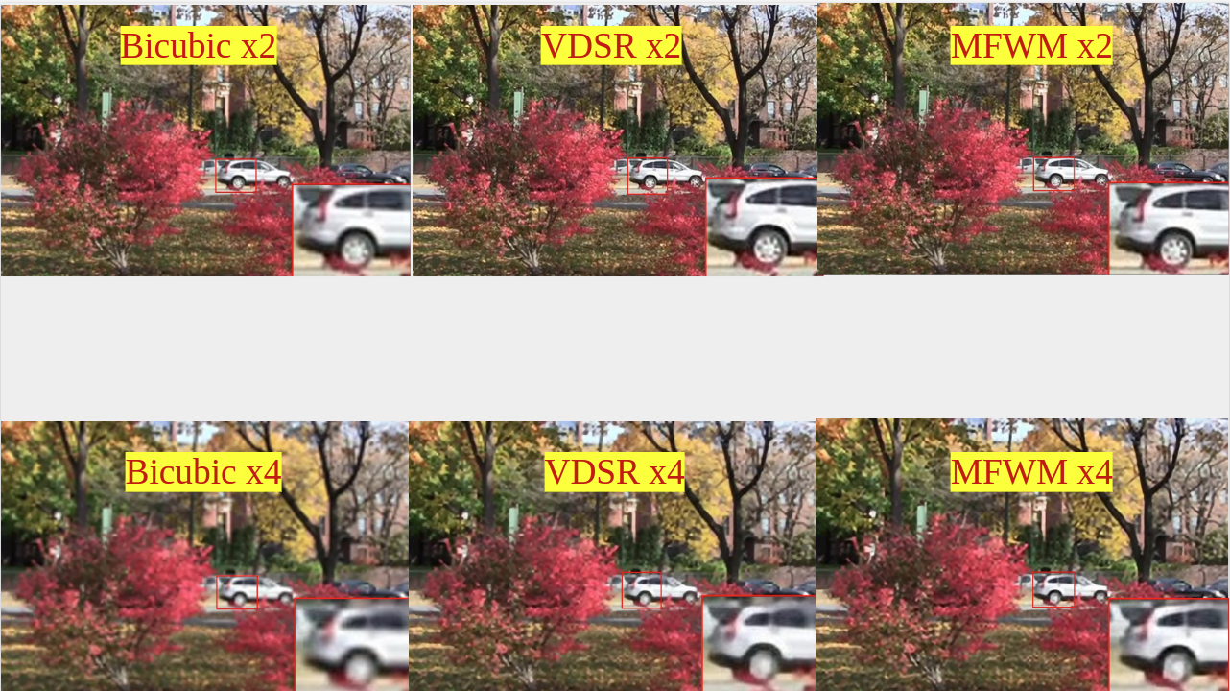

Slide 20
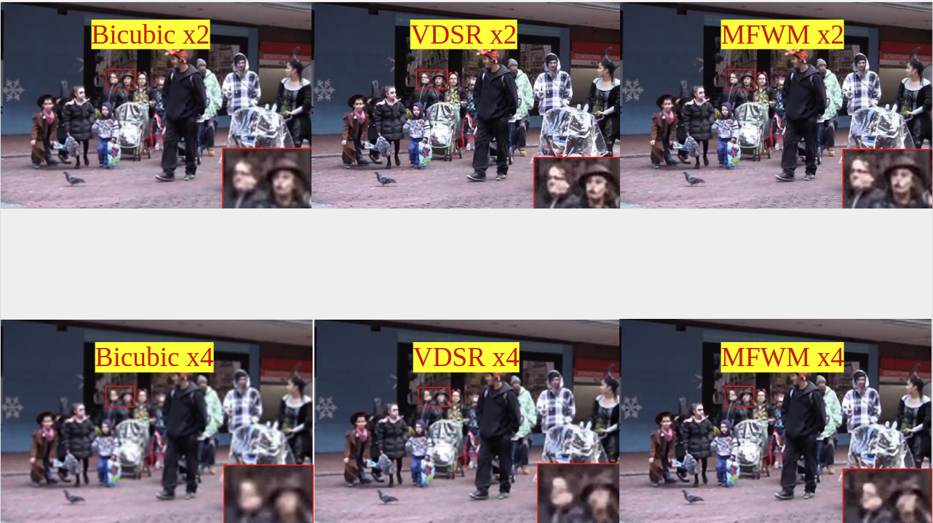

Slide 21
Conclusion & Next Steps
This project builds on the multi-frame super-resolution approach by using wavelet analysis to train convolutional neural networks (CNNs).
The approach begins by applying wavelet decomposition on video segments for multi-scale assessment. Then, several CNNs are trained independently to approximate wavelet multi-scale characterizations.
This project presents a learning-based method for preserving fine features in low-resolution multi-frame images.
Future research could explore recursive multi-level wavelet decomposition to achieve higher upscaling factors while maintaining computational feasibility.
Optimization for Deployment: Simplifying the architecture or leveraging model compression techniques could reduce the computational burden, enabling real-time implementation on edge devices.

Slide 22
Thank You

